Slide 1









Problem Statement
Intel Products Sentiment Analysis from Online Reviews

Slide 2

Unique Idea
This project analyzes customer sentiment towards Intel products using a multi-stage approach:
Phase 1: Data Gathering
The project uses web scraping techniques with Selenium to gather customer reviews from Amazon product pages. Links to Intel product pages are stored in a file, and the script iterates through them to download and save the reviews into a CSV file.
Phase 2: Sentiment Analysis & Visualization
Initial data cleaning is performed to remove irrelevant information.
Two sentiment analysis techniques are applied to each review:
NLTK's VADER (rule-based): Produces a compound sentiment score ranging from -1 (negative) to +1 (positive).
Hugging Face Transformers (BERTweet): Classifies reviews as "positive," "negative," or "neutral."
The distribution of sentiment across the reviews is visualized with bar charts.
Phase 3: Aspect-Based Sentiment Analysis (ABSA)
Focusing specifically on negative reviews, the project leverages spaCy to identify common nouns that often trigger negative reactions, revealing "aspects" users find problematic.
A DeBERTa model fine-tuned for ABSA is used to determine the specific sentiment directed towards these identified aspects in each negative review. For example, if "battery life" is identified as an aspect, the ABSA model might predict "negative" sentiment toward it based on the context of the review.

Slide 3
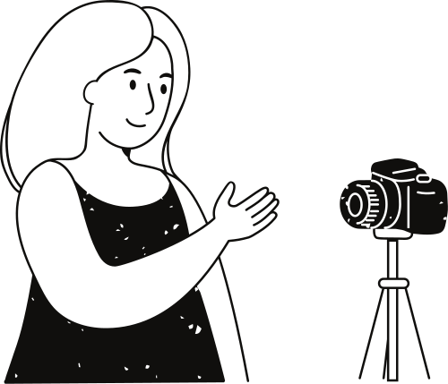
Contd.
Phase 4: Insights and Actionable Recommendations
By combining insights from general sentiment analysis and detailed ABSA results, the project provides a deep understanding of customer feedback. It identifies specific product areas and features causing positive and negative reactions.
This information can help Intel to:
Prioritize Product Improvements: Focus development efforts on addressing negative aspects with high frequency.
Marketing and Messaging: Leverage positive aspects to strengthen marketing and highlight user benefits.
Enhance Customer Support: Anticipate common issues and tailor support strategies based on the identified negative aspects.
In essence, this project moves beyond simple sentiment classification by exploring the "why" behind negative reviews. It empowers Intel to be more responsive to customer needs and proactively enhance its product strategy based on granular customer insights.

Slide 4


Automated Review Scraping:
Multi-page scraping: Extracts reviews from multiple pages of an Amazon product review section.
Comprehensive review data: Captures key information from each review.
Robust error handling: Includes retries for handling timeout exceptions and missing elements during the scraping process.
Proxy support: Allows using a proxy server for bypassing geographical restrictions or avoiding rate limiting.
01.
Features offered by this project
Multi-faceted and Aspect-Based Sentiment Analysis:
NLTK SentimentIntensityAnalyzer (VADER):
Computes sentiment scores for each review using a lexicon-based approach and utilizes a pre-trained BERTweet model for more advanced sentiment classification.
ABSA with DeBERTa model:
Employs a pre-trained DeBERTa model specialized for ABSA to analyze the sentiment specifically towards each extracted aspect.
02.
The code, beyond basic sentiment analysis, showcases advanced techniques like LSTM and ULMFiT. These demonstrate potential for building more sophisticated, customized sentiment models tailored for analyzing scraped Amazon reviews.
Data Integration & Visualization:
Combines sentiment scores: Integrates sentiment analysis results (from both VADER and BERTweet) and ABSA results into a unified DataFrame.
Saves updated data: Writes the complete data with sentiment and ABSA scores to a new CSV file ("updated_reviews.csv").
Basic visualization: Includes code for generating bar charts to represent the distribution of positive, negative, and neutral sentiments in the reviews.
03.

Slide 5

Process Flow
01
02
03
04
Data Collection Web scraping with Python to gather Intel product reviews from various online sources.
Multi-Model Analysis Applying multiple sentiment analysis models (FastText, LSTM, NLTK, RoBERTa, ULMFiT, VADER) to classify sentiments in the collected reviews.
Visualization Creating word clouds for positive, negative, and neutral reviews to visually represent common themes and frequently mentioned terms.
Aspect-Based Analysis Using ABSA with DeBERTa to identify specific product aspects and their associated sentiments, providing detailed insights for product improvement.

Slide 6
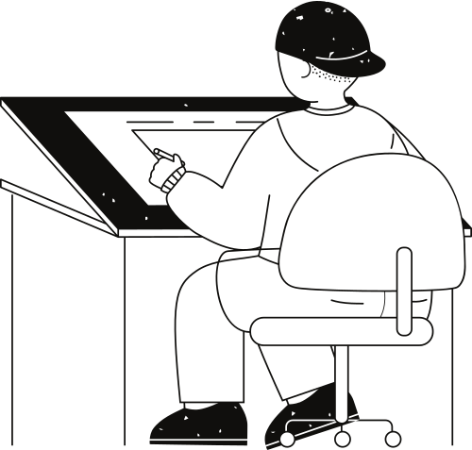
Data collection and
pre-processing
Review labelling with aspect and sentiment analysis
Data
splitting
Word
Tokenization
Aspect-Based Sentiment Detection Model
Aspect Detection
Model
Training Vectors
(aspect and sentiment)
Model Training
(training
vectors and training labels)
Model Training
(training
vectors and training labels)
Predicted Aspect-based Sentiment Polarity
Genereating features from the model and training/testing data
+
Model Testing
(testing
vectors )
Model Testing
(testing
vectors )
Testing Vectors
(aspect and sentiment)
Loading a trained word embedding models
Sentiment Analysis Architecture

Slide 7

Technologies Used
Data Collection
Sentiment Analysis Models
Python web scraping libraries (e.g., BeautifulSoup, Scrapy)
APIs for accessing review platforms
FastText
LSTM
NLTK
RoBERTa
ULMFiT
VADER
Visualization
Advanced Analysis
Word Cloud libraries (e.g., WordCloud)
Database systems (e.g., SQL, MongoDB)
Data visualization tools (e.g., Matplotlib, Plotly)
Aspect-Based Sentiment Analysis (ABSA)
DeBERTa model
Natural Language Processing libraries (e.g., spaCy, NLTK)

Slide 8
Contributions
Anubhav Mazumder:
Aspect-Based Sentiment Analysis (ABSA)
DeBERTa
Nilotpal Basu:
WordClouds
Data cleaning
01.
04.
Debjit Mandal:
ULMFit
RoBERTa
LSTM
Anubrato Basu:
Provided the architectural design
Minor bug fixes
02.
05.
Ankit Dey:
Data Storage
Data Scrapping
03.

Slide 9

Final reflections and future steps
Final Reflections:
Our project successfully used VADER, ULMFiT, NLTK, RoBERTa, and DeBERTa models to analyze sentiment in Intel product reviews.
Models like RoBERTa and DeBERTa provided high accuracy and nuanced insights.
The analysis highlighted common themes in customer feedback, aiding Intel in identifying strengths and areas for improvement.
Future Steps:
Fine-tune models with larger datasets for improved accuracy.
Implement real-time sentiment analysis for timely insights.
Expand to aspect-based and multilingual sentiment analysis.
Deploy the model as a web service for broader integration.
Continuously update the models to adapt to new data trends.

Slide 10



Thank you very much!

